Slide 1

Myntra Case Study
Presented by: Shivani Awasthi

Slide 2

Order of Business
Data Cleaning and Preparation
Check for duplicate values in your dataset and remove them.
Standardize the "DiscountOffer" column to a single format, ensuring all values are uniform.
Identify rows where both "DiscountPrice" and "DiscountOffer" are null and fill the "DiscountPrice" with the average discount price of the respective category.
Replace all null values in the "SizeOption" column with the text "Not Available."
Data Analysis
Calculate the overall average original price for products with ratings greater than 4
Count the number of products with a discount offer greater than 50% OFF.
Count the number of products available in size "M.“
Create a new column to label the products as "High Discount" if the discount offer is greater than 50% OFF, otherwise label them as "Low Discount."
Data Retrieval
Use VLOOKUP/XLOOKUP to find the product brand, price, and rating of the product with Product_id "11226634".
Find the "DiscountPrice" for the product with the Product ID "6744434" using the INDEX and MATCH functions.
Utilize nested xlookup to find any column’s detail of a product with it’s product id.

Slide 3

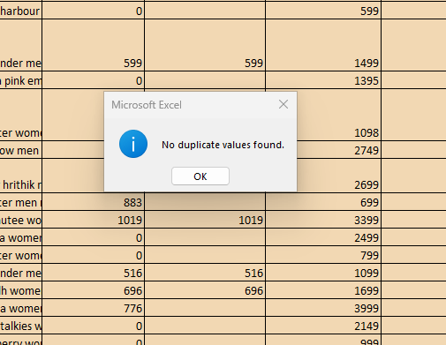

Data Cleaning and Preparation
Problem 1 Check for duplicate values in your dataset and remove them.
Resolution: There are no duplicates found.

Slide 4
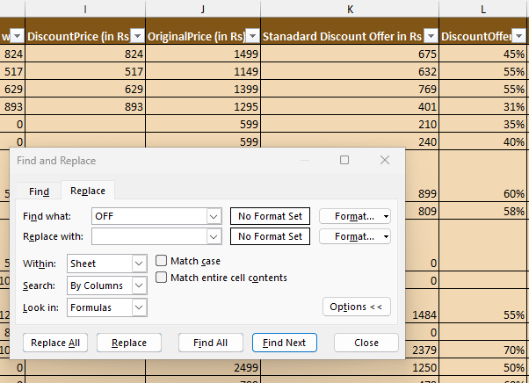
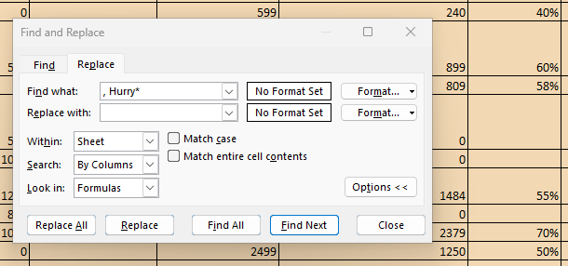
Data Cleaning and Preparation
Problem 2 Standardize the "DiscountOffer" column to a single format, ensuring all values are uniform.
Resolution: I have followed the following steps to standardize the DiscountOffer to a single format i.e. in “Rs.”:
Step1: Cleaned the Values “OFF” and “Hurry*” using “Find and Replace”

Slide 5
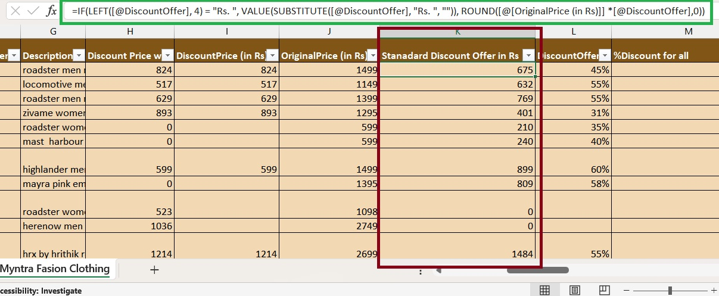
Data Cleaning and Preparation
Continue Problem 2 Standardize the "DiscountOffer" column to a single format, ensuring all values are uniform.
Step 2: Inserted a new cell for standard values with below formula:
=IF(LEFT([@DiscountOffer], 4) = "Rs. ", VALUE(SUBSTITUTE([@DiscountOffer], "Rs. ", "")), ROUND([@[OriginalPrice (in Rs)]] *[@DiscountOffer],0))

Slide 6
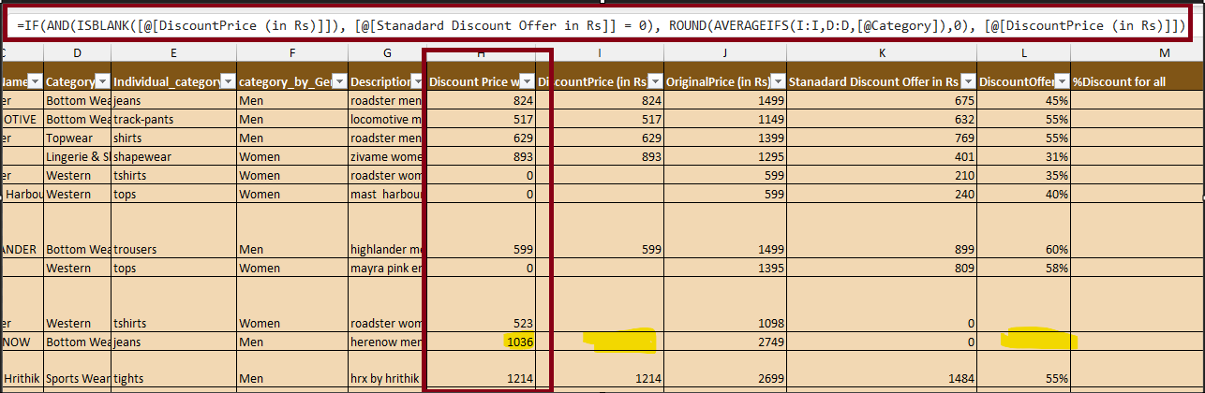
Data Cleaning and Preparation
Problem 3 Identify rows where both "DiscountPrice" and "DiscountOffer" are null and fill the "DiscountPrice" with the average discount price of the respective category.
Resolution: Created a new column with the below formula where:
I have first looked for the blank value in Discount price and discount offer,
Then used Average function to fill the value in blank discount price
I have then round of the value to get the whole numbers
=IF(AND(ISBLANK([@[DiscountPrice (in Rs)]]), [@[Stanadard Discount Offer in Rs]] = 0), ROUND(AVERAGEIFS(I:I,D:D,[@Category]),0), [@[DiscountPrice (in Rs)]])

Slide 7
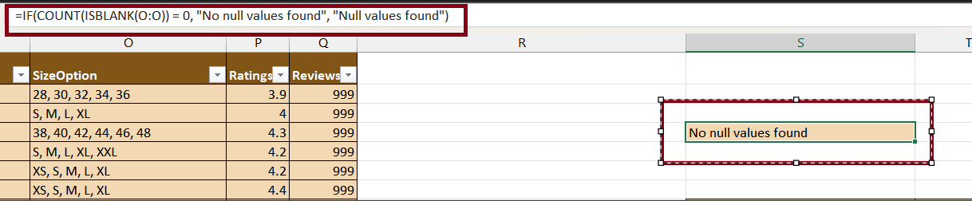
Data Cleaning and Preparation
Problem 4 Replace all null values in the "SizeOption" column with the text "Not Available."
Resolution: There are no null or blank values found in the “SizeOption” Column. I have used find option and then also tested with the below formula:
=IF(COUNT(ISBLANK(O:O)) = 0, "No null values found", "Null values found")

Slide 8
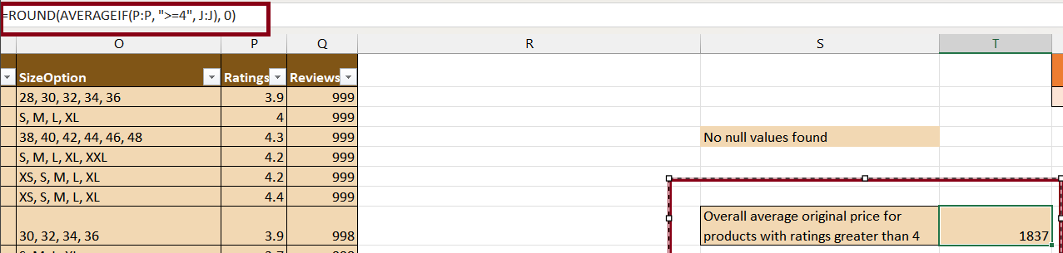
Data Analysis
Problem 1 Calculate the overall average original price for products with ratings greater than 4
Resolution: Calculated average using “AVERAGEIF” function as shown below:
=ROUND(AVERAGEIF(P:P, ">=4", J:J), 0)

Slide 9
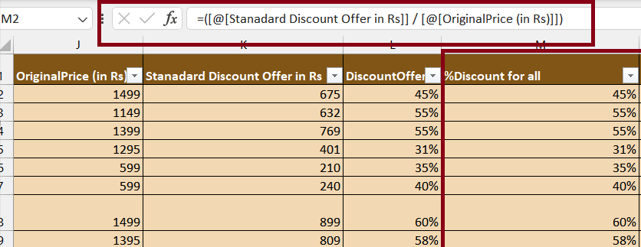
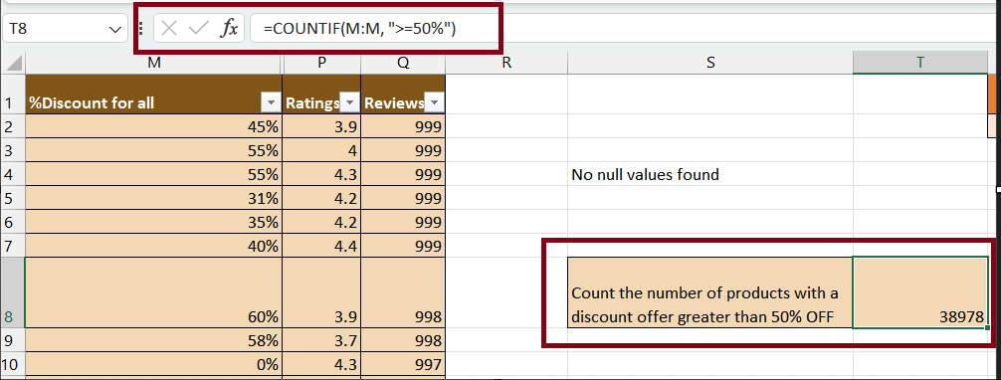
Data Analysis
Problems 2 Count the number of products with a discount offer greater than 50% OFF.
Resolution: Please refer the below steps:
Created a new column “%Discount for all” to get original % from “Standard Discount Offer in rs” column by using below formula: =([@[Stanadard Discount Offer in Rs]] / [@[OriginalPrice (in Rs)]])
ii. Now counted the product which has 50% or 50% plus off
=COUNTIF(M:M, ">=50%“)

Slide 10
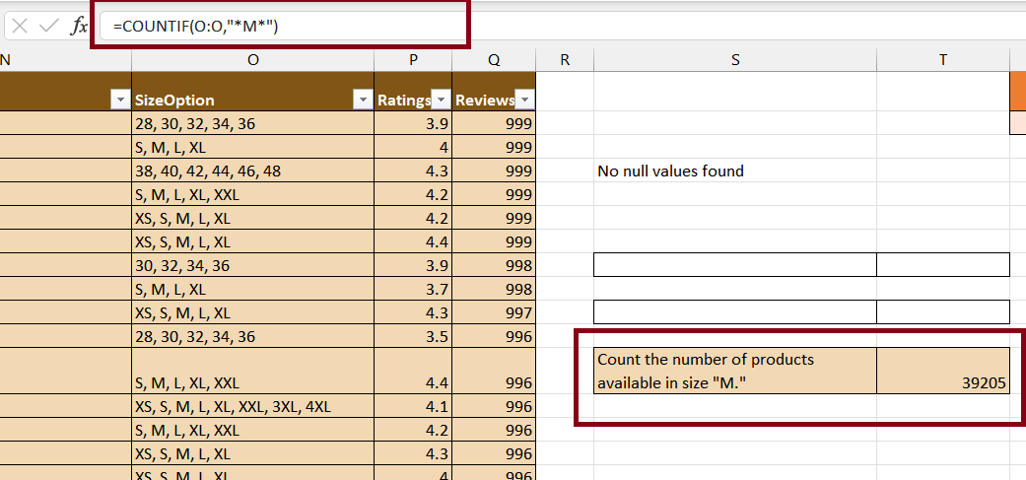
Data Analysis
Problem 3 Count the number of products available in size "M.“
Resolution: Counted the value using below formula
=COUNTIF(O:O,"*M*")

Slide 11
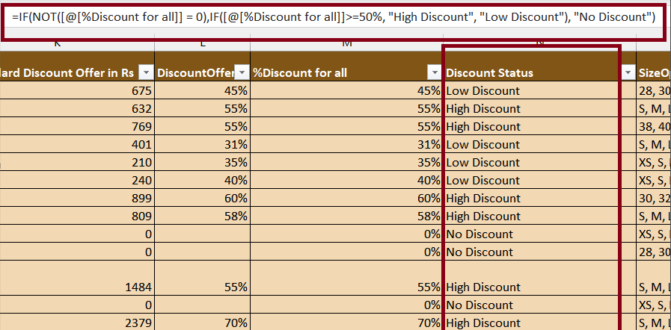
Data Analysis
Problem 4 Create a new column to label the products as "High Discount" if the discount offer is greater than 50% OFF, otherwise label them as "Low Discount."
Resolution: Used the below formula to provide a label based on discount offer:
=IF(NOT([@[%Discount for all]] = 0),IF([@[%Discount for all]]>=50%, "High Discount", "Low Discount"), "No Discount")

Slide 12
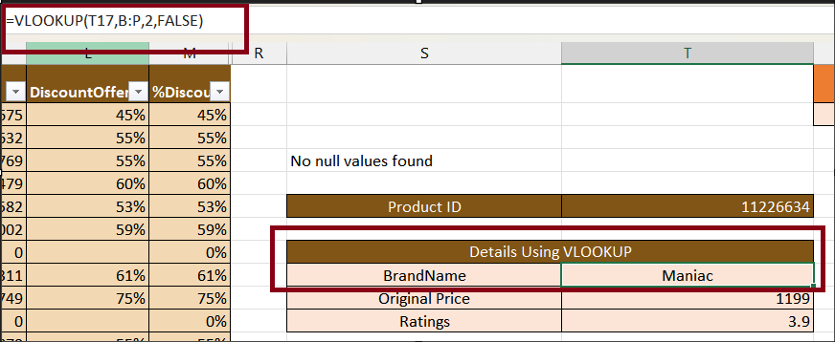
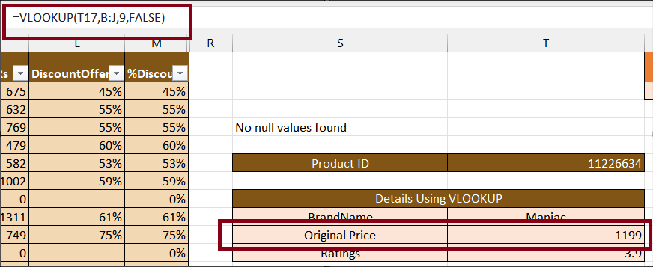
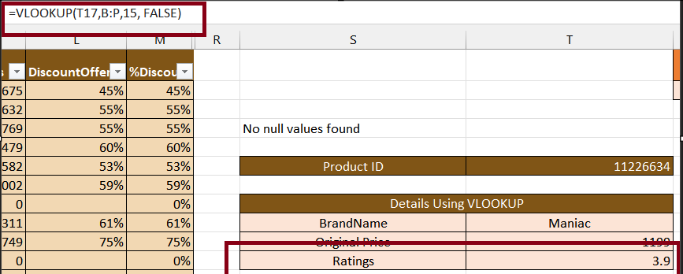
Data Retrieval and Lookup
Problem 1 Use VLOOKUP/XLOOKUP to find the product brand, price, and rating of the product with Product_id "11226634".
Resolution: I have tried with both. Please refer the below formulas and snapshots:
Using VLOOKUP
Brand: =VLOOKUP(T17,B:P,2,FALSE)
Original Price: =VLOOKUP(T17,B:J,9,FALSE)
Rating: =VLOOKUP(T17,B:P,15, FALSE)

Slide 13
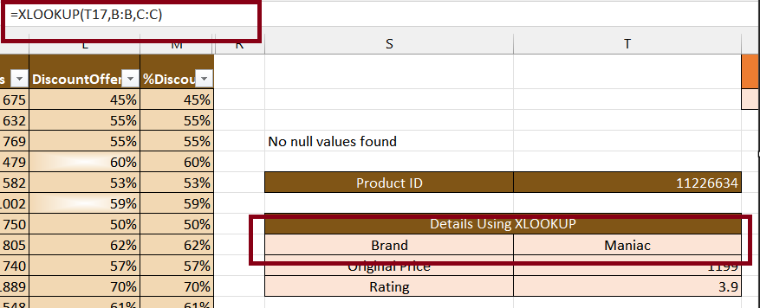
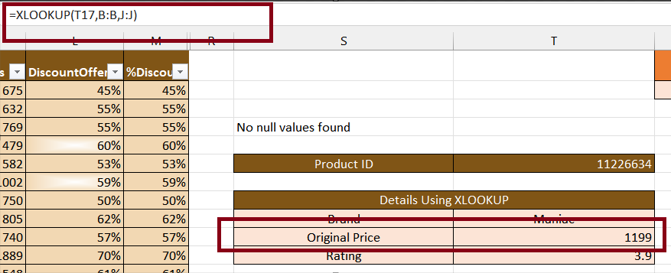
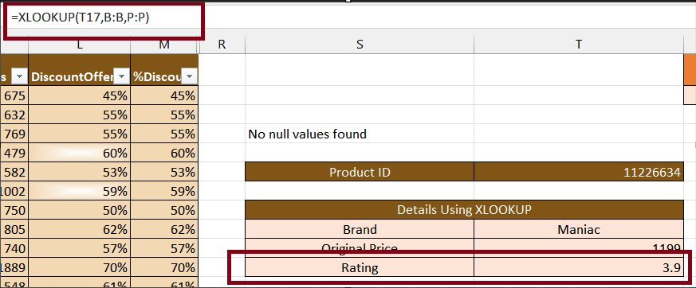
Data Retrieval and Lookup
Problem 1 Use VLOOKUP/XLOOKUP to find the product brand, price, and rating of the product with Product_id "11226634".
Resolution: I have tried with both. Please refer the below formulas and snapshots:
Using XLOOKUP
Brand: =XLOOKUP(T17,B:B,C:C)
Original Price: =XLOOKUP(T17,B:B,J:J)
Rating: =XLOOKUP(T17,B:B,P:P)

Slide 14
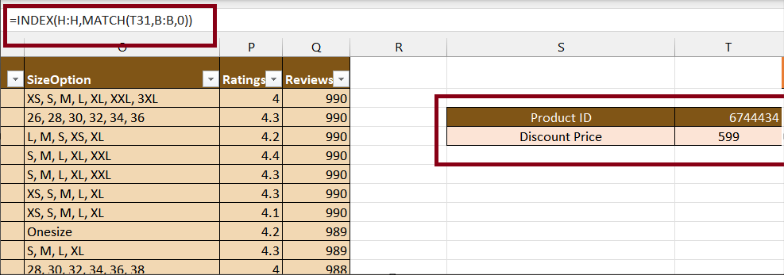
Data Retrieval and Lookup
Problem 2 Find the "DiscountPrice" for the product with the Product ID "6744434" using the INDEX and MATCH functions.
Resolution: Please refer the below formula:
=INDEX(H:H,MATCH(T31,B:B,0))

Slide 15
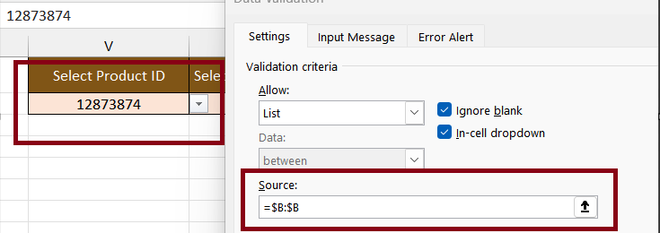
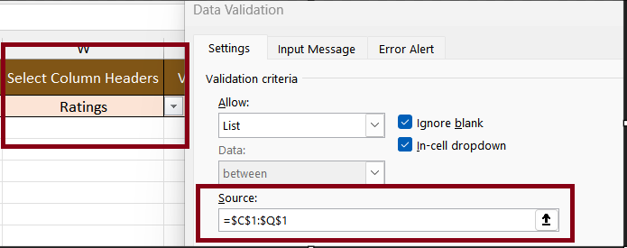
Data Retrieval and Lookup
Problem 3 Utilize nested xlookup to find any column’s detail of a product with it’s product id.
Resolution: I have achieved it with 3 steps. Please refer the details below:
Created a list of “EmployeeID” using data validation
II. Created a list of “Column Headers” using data validation

Slide 16
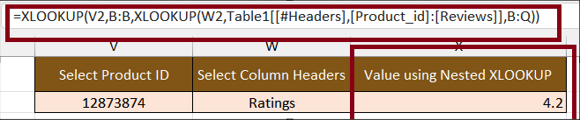
Data Retrieval and Lookup
Continue Problem 3 Utilize nested xlookup to find any column’s detail of a product with it’s product id.
Resolution: Please refer the below step 3:
III. Used that list in nested XLOOKUP formula to get dynamic value for any columns:
=XLOOKUP(V2,B:B,XLOOKUP(W2,Table1[[#Headers],[Product_id]:[Reviews]],B:Q))

Slide 17

Presented by: Shivani Awasthi

